Slide 1
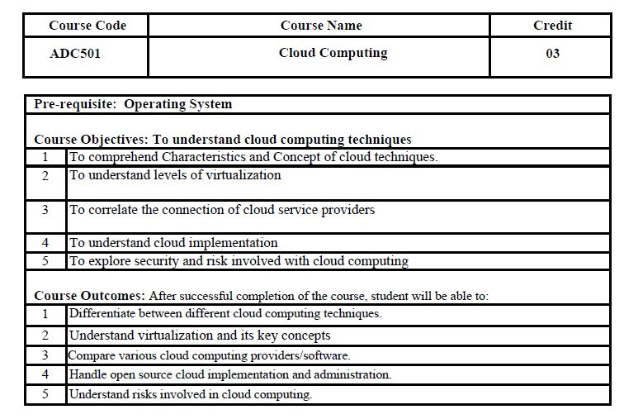

Slide 2
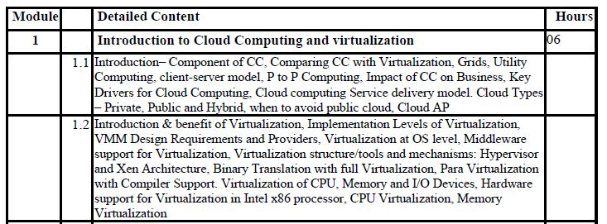
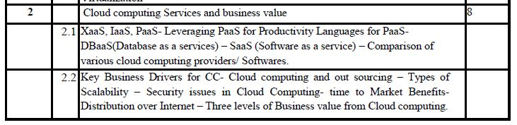

Slide 3
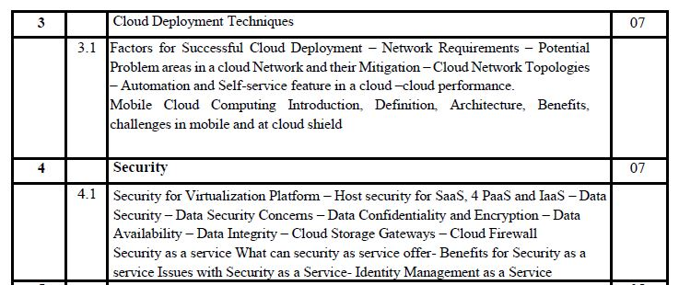
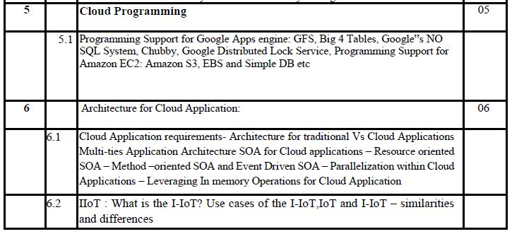

Slide 4
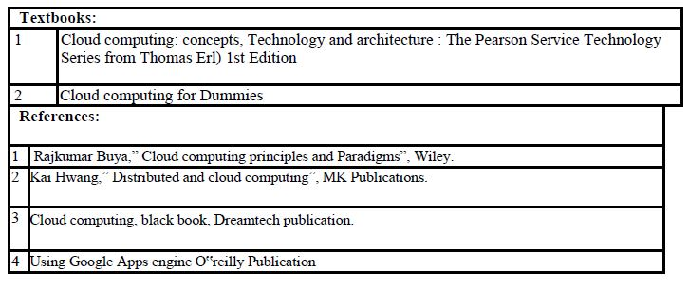

Slide 5
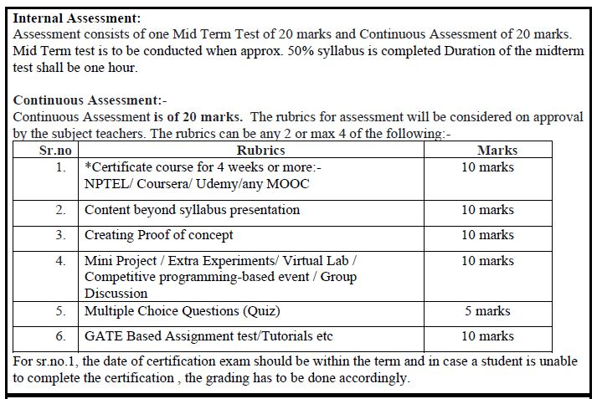

Slide 6
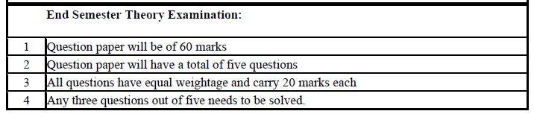

Slide 7
Module No. | Module Name | Hours | Marks
1 | Introduction to Cloud Computing and virtualization | 6 | 15
2 | Cloud computing Services and business value | 8 | 21
3 | Cloud Deployment Techniques | 7 | 18
4 | Security | 7 | 18
5 | Cloud Programming | 5 | 13
6 | Architecture for Cloud Application | 6 | 15
Total Hours and Marks |  | 39 | 100

Slide 8
Module 1 Introduction to Cloud Computing and virtualization
Subject: Cloud computing
Mr. AJINKYA VALANJOO

Slide 9
Overview
Introduction to Cloud Computing
Cloud characteristics
Cloud computing components
Comparing of cloud computing with Peer to peer architecture, Client server, Distributed, Grid
Cloud Deployment Model – Public, Private, Community, Hybrid
Service Models – SaaS, PaaS, IaaS

Slide 10
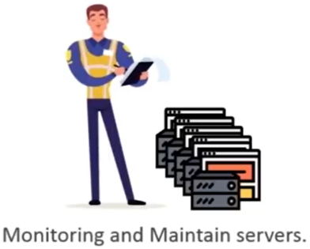
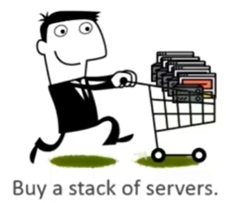
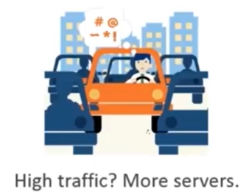
Need of cloud
Suppose you want to host a website, you need following things:

Slide 11
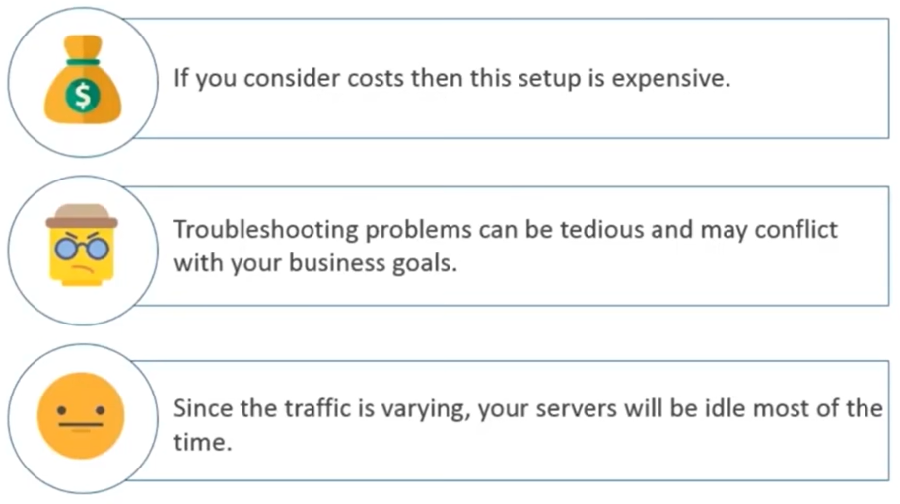
Need of cloud
Problems we were facing before cloud computing are:

Slide 12
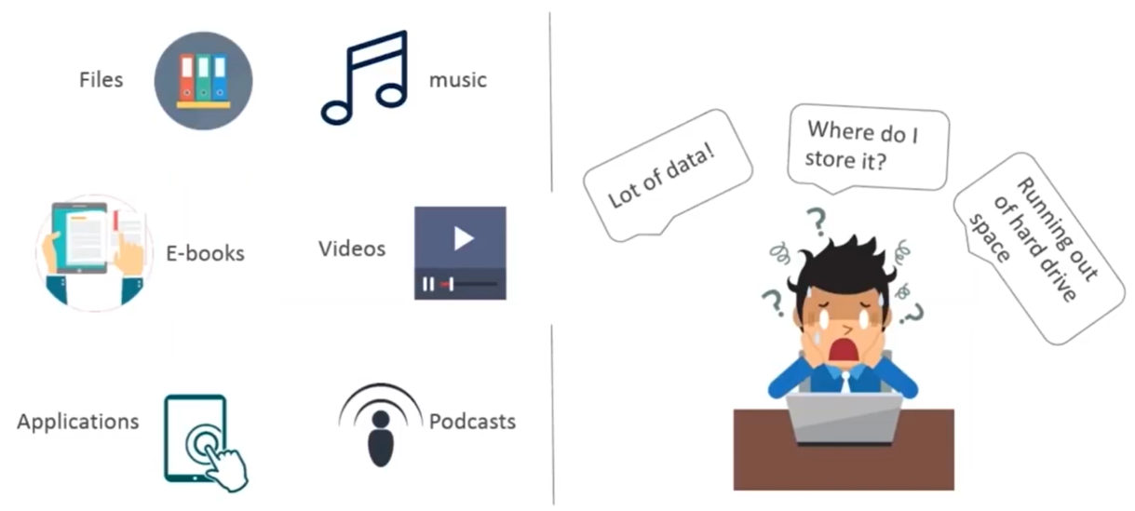
why cloud

Slide 13
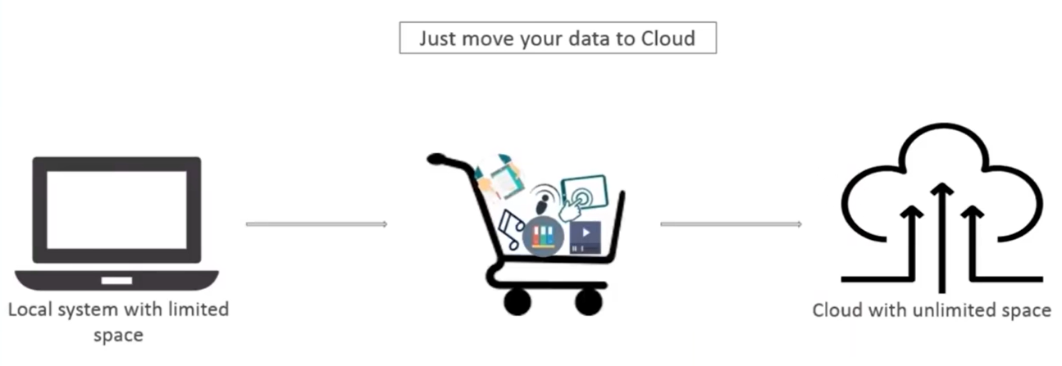
Introduction to cloud

Slide 14
What is Computing?
Includes designing and building hardware / software for a wide range of purposes, processing, structuring and managing various kinds of information
Distributed Computing
Grid Computing
Cluster Computing
Utility Computing
Cloud Computing

Slide 15
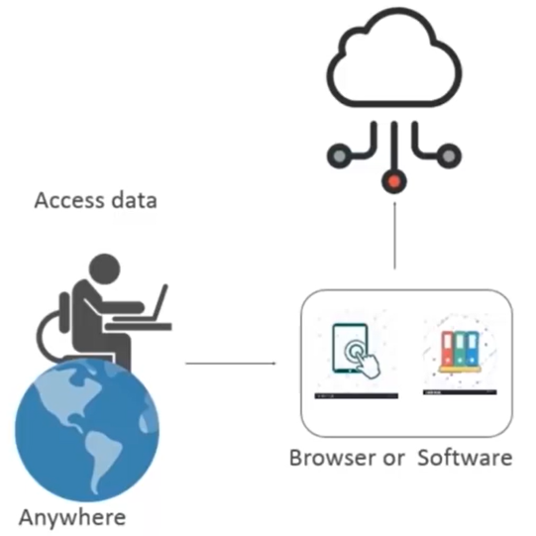
Cloud computing
Storting data/applications on remote servers
Processing data/applications from servers
Accessing data/applications via internet

Slide 16
Introduction to cloud
The term Cloud refers to a Network or Internet.
A cloud is something that exists in a remote area.
Cloud can provide services over public and private networks, i.e., WAN, LAN or VPN.
Applications such as e-mail, web conferencing, customer relationship management (CRM) execute on cloud.

Slide 17
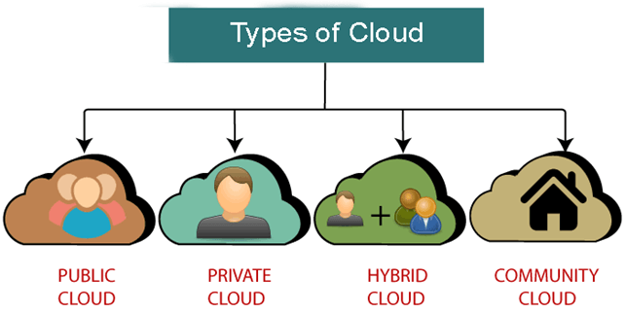
Types of Cloud

Slide 18
Cloud Deployment Models
Public Cloud
Private Cloud
Community Cloud
Hybrid Cloud

Slide 19
Public Cloud
The public cloud infrastructure makes systems and services available to anyone with an internet connection.
Because of its openness, the public cloud is much less secure.
Example: Microsoft, Google App Engine, Windows Azure Services Platform.

Slide 20
Public Cloud
The cloud infrastructure is made available to the general public or a large industry group and is owned by an organization selling cloud services.
E.g. Microsoft Azure, AWS, Google clouds etc.

Slide 21
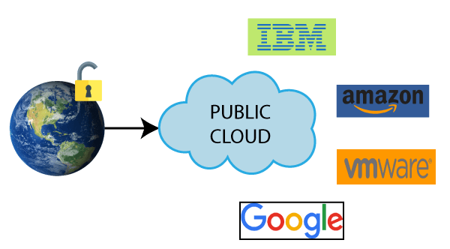
Public Cloud

Slide 22
2. Private cloud
The private cloud infrastructure makes systems and services available to anyone within an organization.
Because of this private characteristic, it is more secure.
Examples: OpenNebula, OpenStack are some examples of this style of deployment.

Slide 23
Private Cloud
The cloud infrastructure is operated solely for a single organization. It may be managed by the organization or a third party, and may exist on-premises or off-premises.
It has high level of security and privacy.
E.g. HP data centers

Slide 24
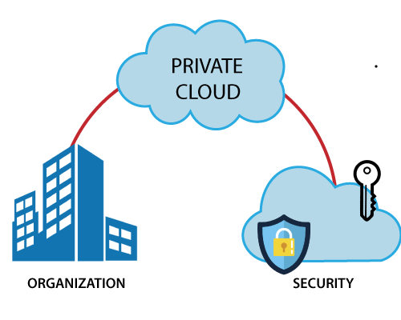
2. Private cloud

Slide 25
3. Hybrid Cloud
Two or more clouds are combined to make up a hybrid cloud infrastructure.
In the majority of cases, public and private clouds blend to make a hybrid cloud, where the private cloud handles crucial tasks and the public cloud handles non-critical tasks.
Examples: Google Application Suite (Gmail, Google Apps, and Google Drive), Office 365 (MS Office on the Web and One Drive), Amazon Web Services.

Slide 26
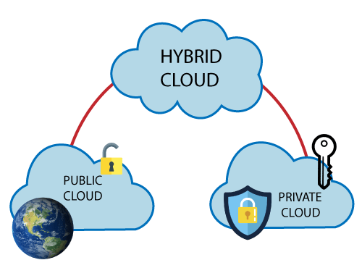
3. Hybrid Cloud

Slide 27
4. Community Cloud
The community cloud infrastructure makes systems and services available to anyone within a group of organizations.
It is owned, managed, and operated by one or more organizations in the community, a third party, or a combination of them.
It allows us to share cloud resources, infrastructure, and other capabilities among various organizations.
Example: Health Care community cloud

Slide 28
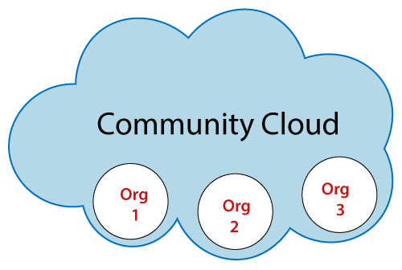
4. Community Cloud
Community clouds are multi-tenant platforms and make it possible for various companies to function on a shared platform.

Slide 29
Community Cloud
The cloud infrastructure is made available to multiple organizations where they share resources and services based on common operational and regulatory requirements.
E.g. IBM SoftLayer cloud

Slide 30
Cloud Computing
“The cloud computing service has grown nearly 80% year-over-year in the last two quarters, and is on pace to hit $7.8 billion in revenue in 2015, four times the 2012 sales of $1.8 billion.”

Slide 31
Cloud Computing
NITS (National Institute of Standards and Technology ) defines Cloud Computing as;
“ Cloud computing is a model for enabling ubiquitous, convenient, on-demand network access to a shared pool of configurable computing resources (e.g networks, servers, storage, applications, and services) that can be rapidly provisioned and released with minimal management effort or service provider interaction. ”

Slide 32
Characteristics
On-demand self-service:
A consumer can unilaterally provision computing capabilities, such as server time and network storage, as needed automatically without requiring human interaction with each service provider
Broad network access:
Capabilities are available over the network and accessed through standard mechanisms that promote use by heterogeneous thin or thick client platforms (e.g., mobile phones, tablets, laptops, and workstations).
Resource pooling
The provider’s computing resources are pooled to serve multiple consumers using a multi-tenant model, with different physical and virtual resources dynamically assigned and reassigned according to consumer demand

Slide 33
Continue..
Rapid elasticity:
- Capabilities can be rapidly and elastically provisioned - in some cases automatically - to quickly scale out; and rapidly released to quickly scale in.
To the consumer, the capabilities available for provisioning often appear to be unlimited and can be purchased in any quantity at any time
Measured service:
Cloud systems automatically control and optimize resource usage by leveraging a metering capability at some level of abstraction appropriate to the type of service
Resource usage can be monitored, controlled, and reported - providing transparency for both the provider and consumer of the service

Slide 34
Some other common characteristics
Massive scale
Resilient computing
Homogeneity
Geographic distribution
Virtualization
Service orientation
Low cost software
Advanced security

Slide 35
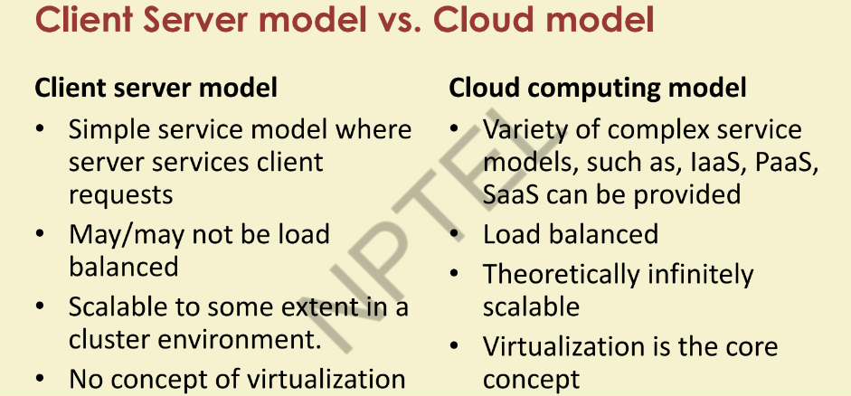

Slide 36
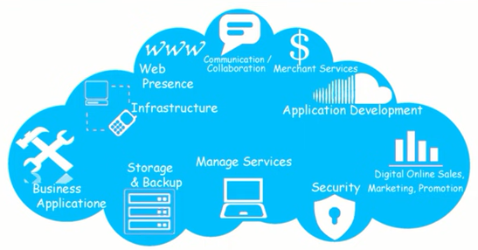
Cloud Services
Cloud services covers a wide range of services that a service provider delivers to the customer via the internet.

Slide 37
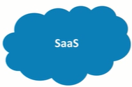
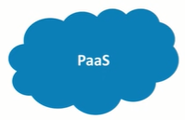
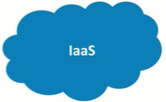
Cloud Service models
Three main cloud services:
Software as a Service
Platform as a Service
Infrastructure as a Service

Slide 38
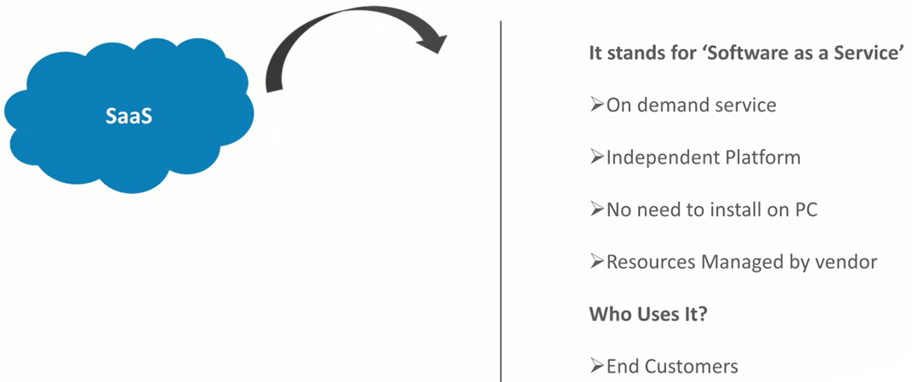
Types of Service model

Slide 39
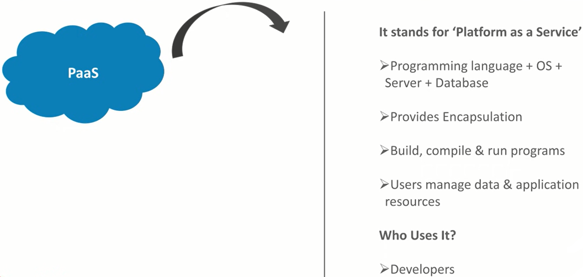
Types of Service model

Slide 40
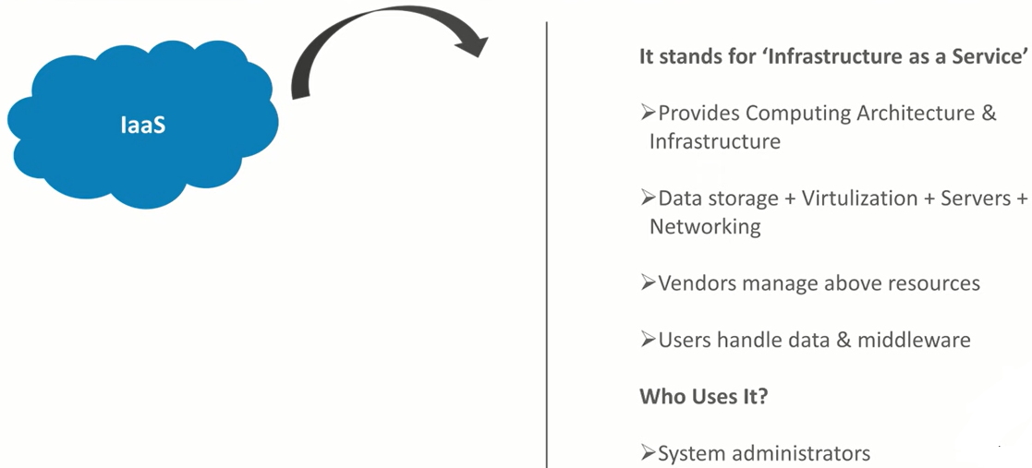
Types of Service model

Slide 41
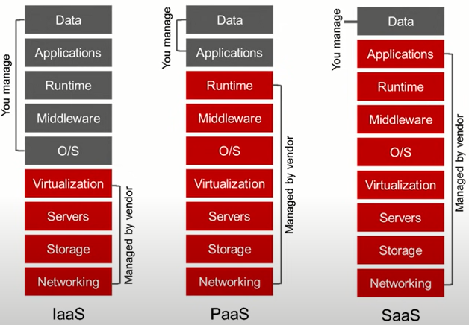
Types of Cloud Services

Slide 42
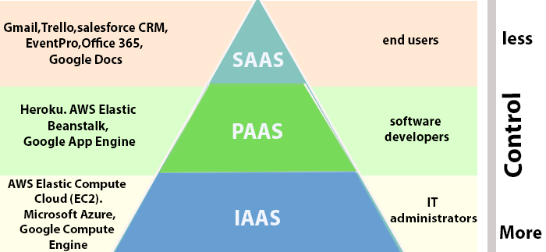
Types of Service model

Slide 43
Cloud Service Models
1. Cloud Software as a Service (SaaS)
2. Cloud Platform as a Service (PaaS)
3. Cloud Infrastructure as a Service (IaaS)

Slide 44
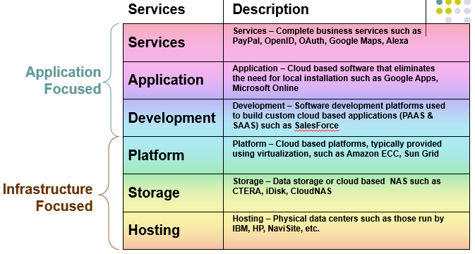

Slide 45
Software as a Service (SaaS)
The capability provided to the consumer is to use the provider’s applications running on a cloud infrastructure.
The applications are accessible from various client devices through a thin client interface such as a web browser (e.g., web-based email).
The consumer does not manage or control the underlying cloud infrastructure including network, servers, operating systems, storage, or even individual application capabilities, with the possible exception of limited user-specific application configuration settings.

Slide 46
Platform as a Service (PaaS)
The capability provided to the consumer is to deploy onto the cloud infrastructure consumer created or acquired applications created using programming languages and tools supported by the provider
The consumer does not manage or control the underlying cloud infrastructure including network, servers, operating systems, or storage, but has control over the deployed applications and possibly application hosting environment configurations

Slide 47
Infrastructure as a Service (IaaS)
The capability provided to the consumer is to provision processing, storage, networks, and other fundamental computing resources.
Consumer is able to deploy and run arbitrary software, which can include operating systems and applications
The consumer does not manage or control the underlying cloud infrastructure but has control over operating systems, storage, deployed applications, and possibly limited control of select networking components (e.g., host firewalls)

Slide 48
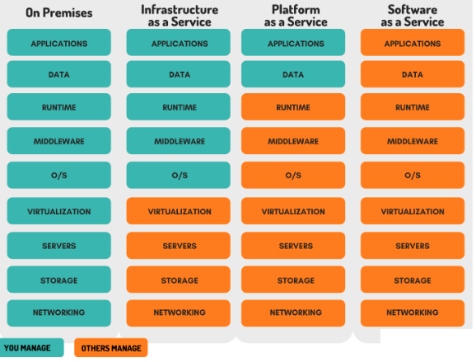

Slide 49
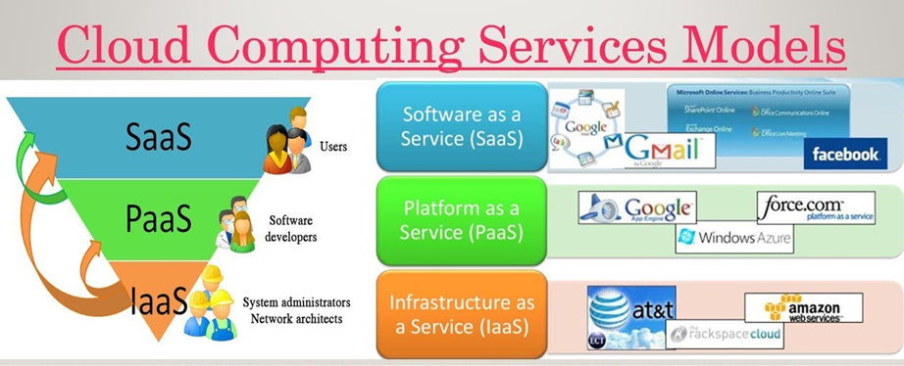

Slide 50
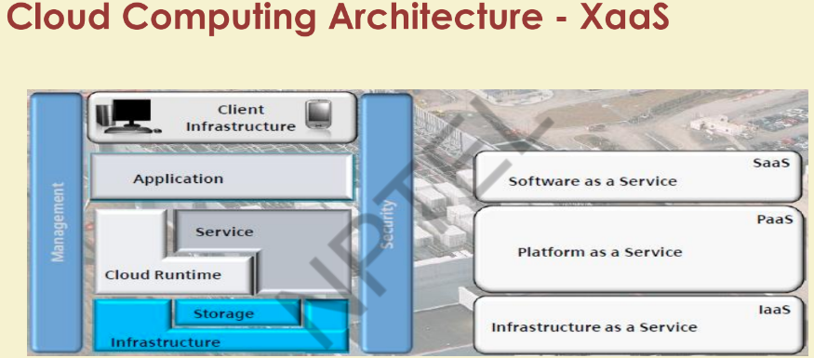

Slide 51
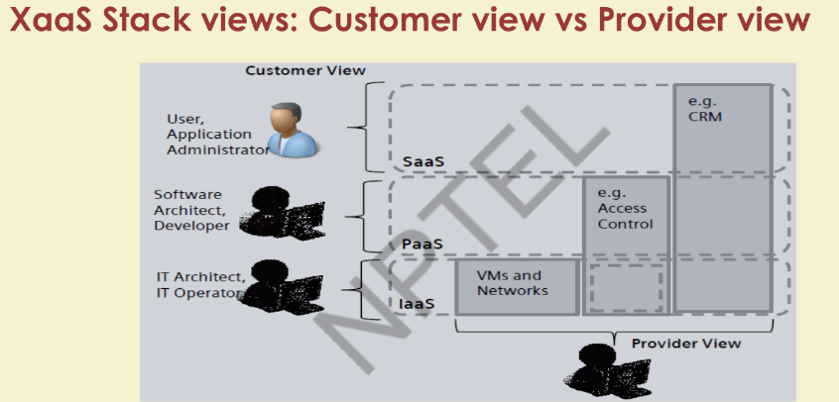

Slide 52
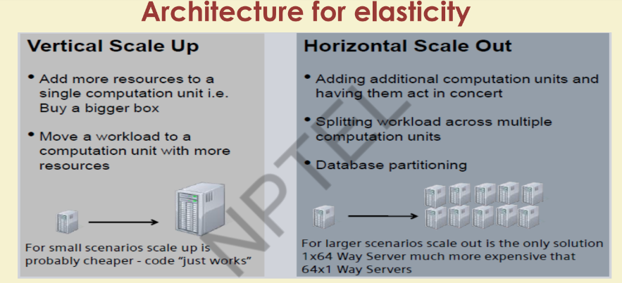

Slide 53
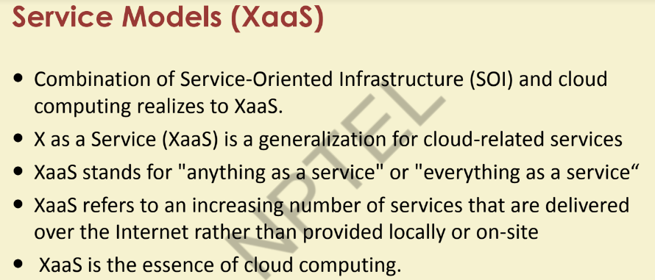

Slide 54
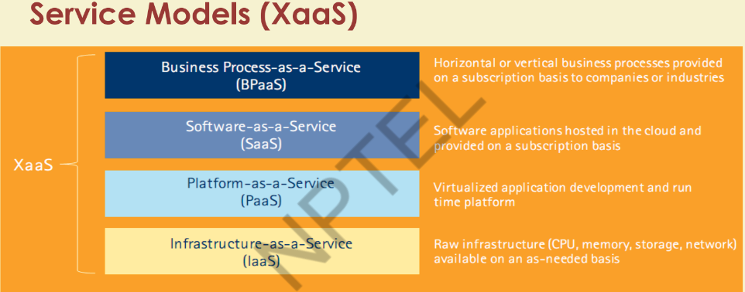

Slide 55
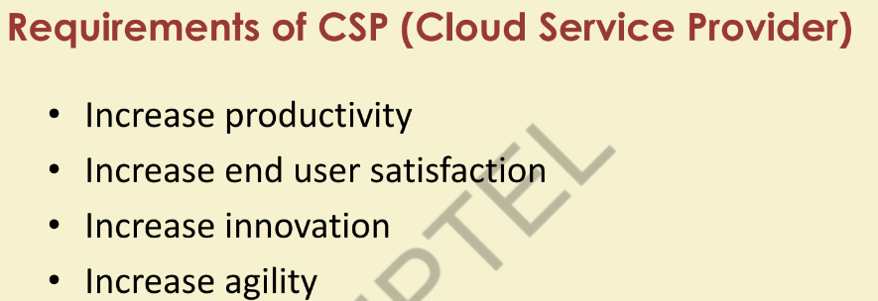

Slide 56
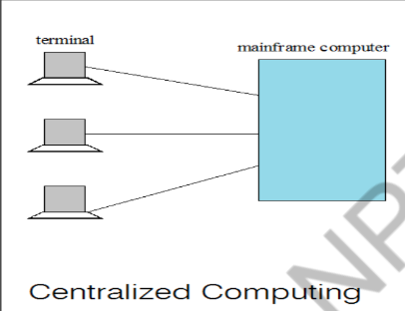
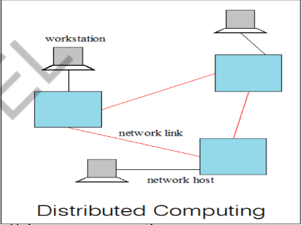
Centralized Vs Distributed Computing

Slide 57
Distributed computing
Controlling and managing is distributed
Uni processor is not a concept
Distributed Processor carries its own local memory and storage
It provides computing services in distributed manner
Each processor communicates with another processor through high speed lines
Components: Workstations, Servers, Personal assistant devices
Examples: Internet, ATM machines, Intranet

Slide 58
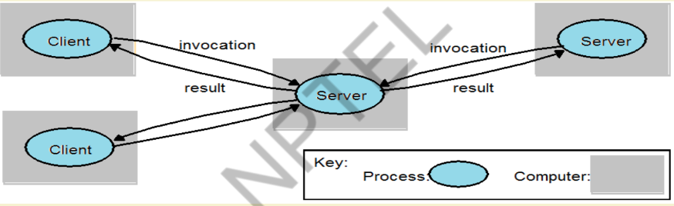
Distributed applications
1. Clients invoke individual servers

Slide 59
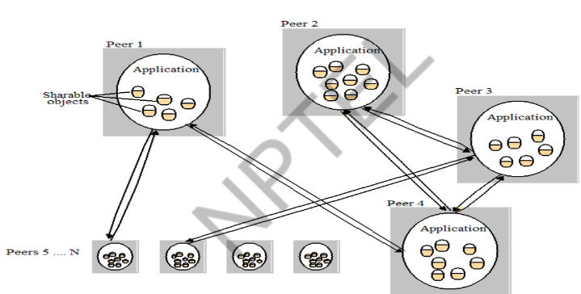
2. A typical distributed application based on peer processes

Slide 60
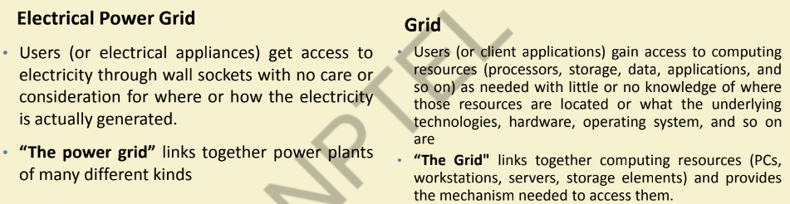
Grid Computing
Grid computing harnesses unused processing cycles of all computers in a network for solving problems too intensive for any stand-alone machine

Slide 61
Application of Grid computing
Today’s Science/Research is based on computations, data analysis, data visualization & collaborations
Computer Simulations & Modelling are more cost effective than experimental methods
Scientific and Engineering problems are becoming more complex & users need more accurate, precise solutions to their problems in shortest possible time
Data Visualization is becoming very important
Exploiting under utilized resources

Slide 62
Cluster Computing
A cluster is a type of parallel or distributed computer system, which consists of a collection of inter-connected stand-alone computers working together as a single integrated computing resource
Key components of a cluster include multiple standalone computers (PCs, Workstations, or SMPs), operating systems, high-performance interconnects, middleware, parallel programming environments, and applications.
Clusters are usually deployed to improve speed and/or reliability over that provided by a single computer
Basic building blocks of clusters are broken down into multiple categories:
• Cluster Nodes
• Cluster Network
• Network Characterization

Slide 63
Utility Computing
Utility Computing is purely a concept which cloud computing practically implements
Utility computing is a service provisioning model in which a service provider makes computing resources and infrastructure management available to the customer as needed, and charges them for specific usage rather than a flat rate.
Some highlights:
a) Pay-for-use Pricing Business Model
b) Data Center Virtualization and Provisioning
c) Solves Resource Utilization Problem
d) Outsourcing
e) Web Services Delivery
f) Automation
Drawbacks: Data Backup , Data Security, Partner Competency, Defining SLA

Slide 64
Advantages
Lower Computer cost
Improved software updates
Improved document format capabilities
Unlimited storage capacity
Increased data reliability
Universal information access
Latest version availability
Easier group collaboration
Device independance

Slide 65
Drawback
Requires constant internet connection
Does not work well with low speed
Features might be limited
Can be slow
Security
Stored data can be lost

Slide 66
Virtualization

Slide 67
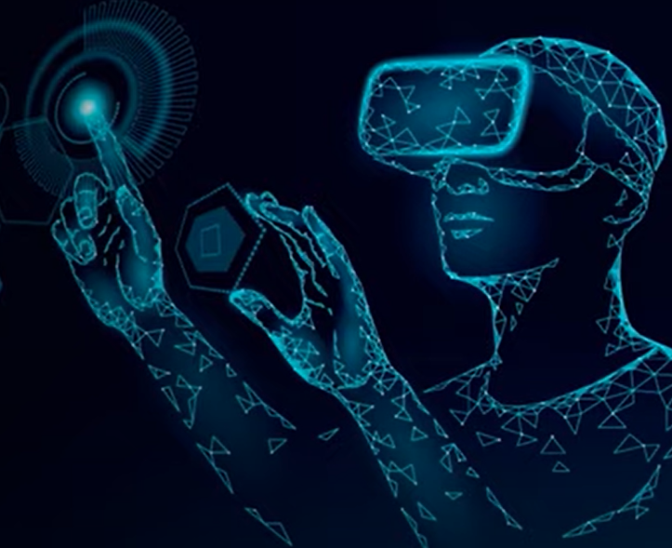
Introduction to Virtualization
Virtualization is the process of creating a virtual environment of something which may include hardware platforms, storage devices, OS, network resources, etc.
It is the process of creating a virtual instance of a device, such as a virtual server or virtual operating system.

Slide 68
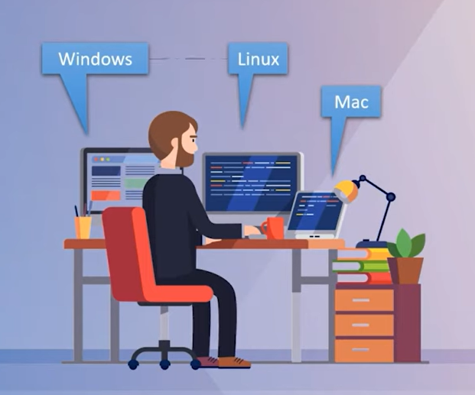
Need of Virtualization
Notes:
https://www.youtube.com/watch?v=Wb68Exu6jtU

Slide 69
Virtualization
Virtualization creates virtual layer using hypervisor software which manages resources assigned to virtual instances.
The newly formed virtual representation is called as virtual machine (VM).
Virtual machine is an emulation or virtual representation of physical system.

Slide 70
Benefits of Virtualization
1. More flexible and efficient allocation of resources.
2. Enhance development productivity.
3. It lowers the cost of IT infrastructure.
4. Remote access and rapid scalability.
5. High availability and disaster recovery.
6. Enables running multiple operating systems.

Slide 71
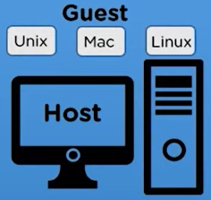
Hypervisor
The virtual machine is referred as a guest machine and physical machine on which the virtual machine is created is known as host machine.
The virtual machine is managed by a software or firmware, which is known as Hypervisor.

Slide 72
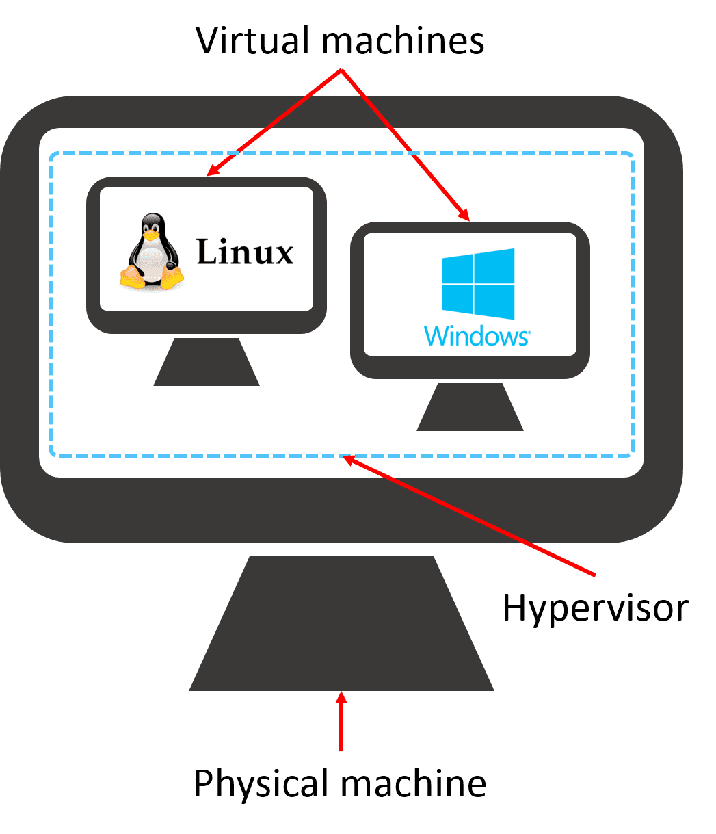
Hypervisor
Hypervisor is a firmware or low-level program that acts as a Virtual Machine Manager (VMM).

Slide 73
Hypervisor
There are two types of hypervisor:
1.Type 1 hypervisor / Native/Bare-Metal Hypervisors
2.Type 2 hypervisor / Hosted Hypervisors

Slide 74
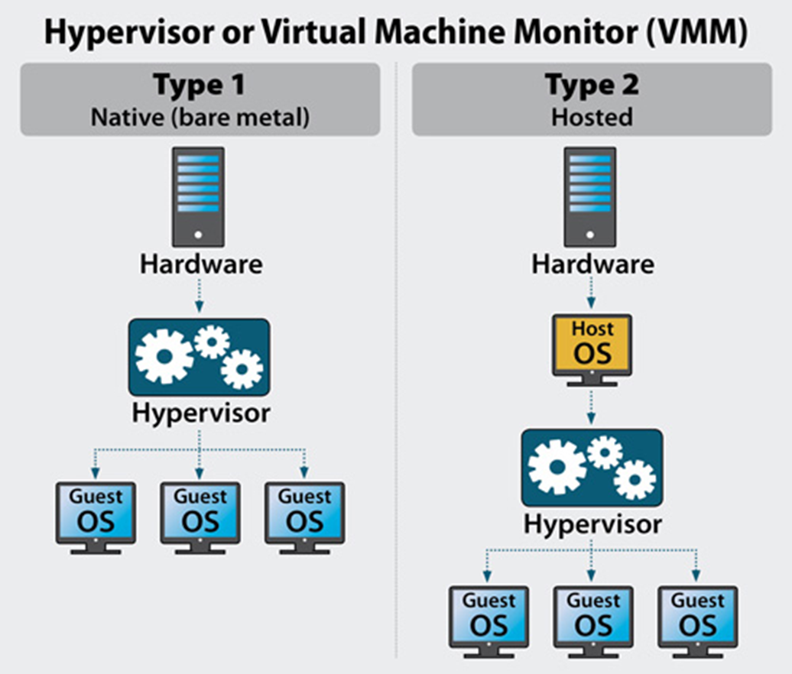
Hypervisor

Slide 75
Type 1 Hypervisor
They are deployed directly over the host hardware.
Direct access to the hardware without any underlying OS or device drivers makes such hypervisors highly efficient for enterprise computing.
VMware ESXi, Microsoft Hyper-V, Oracle VM, and Xen are examples of type 1 hypervisors.

Slide 76
2. Type 2 Hypervisor
They run as an application over a traditional OS.
Developers, security professionals, or users who need to access applications only available on select OS versions often rely on type 2 hypervisors for their operations.
KVM, VMware Server and Workstation, Microsoft Virtual PC, Oracle VM VirtualBox, and QEMU are popular type 2 hypervisors.

Slide 77
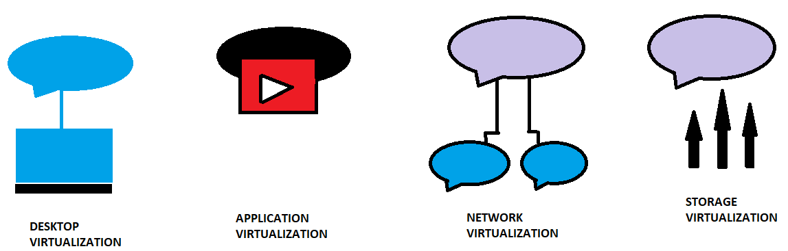
Types of virtualization

Slide 78

Desktop virtualization
It allows us to run multiple desktop OS in each VM.
t allows the user to access their desktop virtually, from any location by a different machine.
Users who want specific operating systems other than Windows Server will need to have a virtual desktop.
Main benefits of desktop virtualization are user mobility, portability, easy management of software installation, updates, and patches.

Slide 79

2. Network virtualization
It basically refers to a system where one can run multiple virtual networks at the same time and each of these networks have a separate control system and data plan.
It also helps you keep a better track of things on the network and allow for good supervision as well as identification of the data usage.
Example : firewall

Slide 80

3. Storage virtualization
Storage virtualization is an array of servers that are managed by a virtual storage system.
The servers aren’t aware of exactly where their data is stored, and instead function more like worker bees in a hive.

Slide 81

4. Application virtualization
Application virtualization helps a user to have remote access of an application from a server.
The server stores all personal information and other characteristics of the application but can still run on a local workstation through the internet.
Example of this would be a user who needs to run two different versions of the same software.

Slide 82
Thank You!

